Slide 1
LSST software stack and deployment on other architectures
William O’Mullane for Andy Connolly with material from Owen Boberg

Slide 2
Docker
What it is and what it does
Docker allows you to build standalone applications with all of their dependencies in a standard and easily shared unit.
Docker Image:
Built from an easily readable/writeable Dockerfile
Install commands you would run in your terminal (apt-get, yum,pip,conda) can almost be directly copied into a Dockerfile.
This includes the instructions for LSST pipelines.
Or pulled from the Docker hub repository
Images on Docker hub can, and often do, serve as the base image for applications you build.
Docker allows you to run standalone applications in a sandbox environment
Docker Container:
A running instance of a Docker image
You can think of it as a lightweight VM
Only uses the resources you give it

Slide 3
Docker
Pros
Completely isolated environment
Need more than one version of python, just make different images/containers.
Truly isolate the LSST stack from your native environment.
Get access to software not available on your host OS.
Example: Macs can not currently run OpSim
A Mac running OpSim through Docker can, however.
Reproducibility:
Easily share the exact environment used to produce a result
Avoid the statement, “Well it worked on my machine”.
Collaboration:
Docker Hub makes it easy to share images
Quickly get people using LSST software while at workshops
No time lost with people trying to update their version of the stack
Just install Docker and pull the image for the software

Slide 4
Docker
Cons
There is a small learning curve to Docker
Have to learn how to mount volumes so you do not lose data when a container is removed
Lose software changes to a container if they are not committed
Security:
Careful steps need to be taken when running Docker on a shared machine
Only privileged users should have access to Docker commands
See: https://github.com/docker/labs/tree/master/security
Some high performance computers centers (HPCs) will not install Docker.
Alternatives: shifter (NCSA), singularity

Slide 5
For LSST DM Stack .. .
The major factors are reliability and reproducibility
Code from build and test environment
Directly to deployment
Including in the JupyterHub (used in the tutorial)
With some work other systems like Spark/Dask can be accomodated
So you can also get the stack running on a machine with docker using e.g.
>docker run -ti lsstsqre/centos:7-stack-lsst_distrib-v15_0

Slide 6
LSST DM Stack builds
GCE Google Compute Engine -yes we pay for it.
TLS Transport Layer Security – handles the SSL
S3sync sync a filesystem to an S3 bucket
Jenkins master on AWS, the agents on Google, and we stuff the results in an AWS S3 bucket

Slide 7
How a “release” is made

Slide 8
File structure for releases

Slide 9
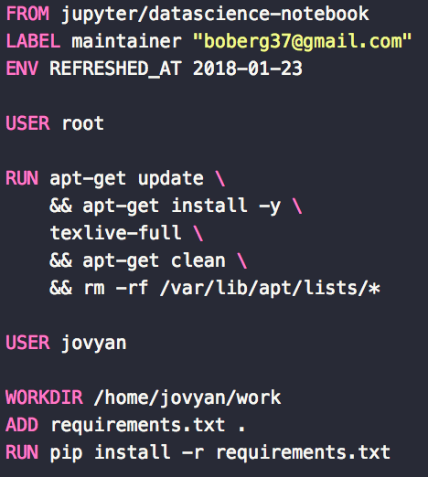
Dockerfile
The commands are easy to read and follow
Commands in PINK are Docker specific commands.
The base image is pulled FROM Docker hub
Installing additional software on top of the base image is done here using apt-get and pip.
https://hub.docker.com/r/oboberg/astroml/

Slide 10
Docker container
Im in a Docker container, now what?
You might have these questions:
How do I get to a command line?
Where do I write my code?
Where do I put my data?
Can I use jupyter lab and/or notebooks?
How do I save code output and edits?

Slide 11
Docker container (MAF example)
Running the Metric Analysis Framework (MAF)
docker run -it \
-v ${PWD}/results:/home/maf/docmaf/maf_local \
-v ${PWD}/my_repos:/home/maf/docmaf/lsst_repos \
-p 8888:8888 \
oboberg/maf:180525
How do I get to a command line?
Where do I write my code?
Where do I put my data?
Can I use jupyter lab and/or notebooks?
How do I save code output and edits?

Slide 12
Docker container (MAF example)
Running the Metric Analysis Framework (MAF)
docker run -it \
-v ${PWD}/results:/home/maf/docmaf/maf_local \
-v ${PWD}/my_repos:/home/maf/docmaf/lsst_repos \
-p 8888:8888 \
oboberg/maf:180525
How do I get to a command line?
docker run -it
Starts the container in an interactive mode.
Gives you access to shell inside of the container.

Slide 13
Docker container (MAF example)
Running the Metric Analysis Framework (MAF)
docker run -it \
-v ${PWD}/results:/home/maf/docmaf/maf_local \
-v ${PWD}/my_repos:/home/maf/docmaf/lsst_repos \
-p 8888:8888 \
oboberg/maf:180525
Where do I put my data?
-v ${PWD}/results:/home/maf/docmaf/maf_local
This option mounts ${PWD}/results on your computer inside the container at /home/maf/docmaf/maf_local
Any new data put in ${PWD}/results on your computer will be available to use in the Docker container

Slide 14
Docker container (MAF example)
Running the Metric Analysis Framework (MAF)
docker run -it \
-v ${PWD}/results:/home/maf/docmaf/maf_local \
-v ${PWD}/my_repos:/home/maf/docmaf/lsst_repos \
-p 8888:8888 \
oboberg/maf:180525
Where do I write my code?
-v ${PWD}/my_repos:/home/maf/docmaf/lsst_repos
Mount ${PWD}/my_repos on your computer inside the container at the path /home/maf/docmaf/lsst_repos
Edit any code in ${PWD}/my_repos as you normally would on a local editor and the updated code will automatically available in the container
Switching git branches in ${PWD}/my_repos will also switch branches in the container

Slide 15
Docker container (MAF example)
Running the Metric Analysis Framework (MAF)
A note about LSST software
-v ${PWD}/my_repos:/home/maf/docmaf/lsst_repos
Once in the container you can eups declare and setup packages to run off of a GitHub repos.
Example:
sims_maf is cloned into ${PWD}/my_repos on my local host
Once in the container go to /home/maf/docmaf/lsst_repos/sims_maf
eups declare sims_maf -r . -t $USER ($USER is docmaf in this container)
setup sims_maf -t $USER
scons
The container will now be running MAF off of the GitHub repo that is stored (and edited) locally, but mounted in the container.
See https://pipelines.lsst.io/install/docker.html#how-to-develop-packages-inside-docker-containers for more info.

Slide 16
Docker container (MAF example)
Running the Metric Analysis Framework (MAF)
docker run -it \
-v ${PWD}/results:/home/maf/docmaf/maf_local \
-v ${PWD}/my_repos:/home/maf/docmaf/lsst_repos \
-p 8888:8888 \
oboberg/maf:180525
Can I use jupyter lab and/or notebooks?
-p 8888:8888
Read as host_port:container_port
Maps port 8888 of your host to port 8888 in the container
Command in container:
jupyter lab —ip=0.0.0.0 —no-browser
Copy and paste the url you are given into a local browser and start making notebooks.
This does of course require jupyter to be installed in the container, which is the case for oboberg/maf:180525 image.

Slide 17
Docker container (MAF example)
Running the Metric Analysis Framework (MAF)
docker run -it \
-v ${PWD}/results:/home/maf/docmaf/maf_local \
-v ${PWD}/my_repos:/home/maf/docmaf/lsst_repos \
-p 8888:8888 \
oboberg/maf:180525
How do I save code output and edits?
-v ${PWD}/results:/home/maf/docmaf/maf_local
-v ${PWD}/my_repos:/home/maf/docmaf/lsst_repos
When in the container, anything created, edited, or removed in /home/maf/docmaf/maf_local or /home/maf/docmaf/lsst_repos will have the same effect for content in ${PWD}/results and ${PWD}/my_repos, respectively.
Be careful what you mount!
There are security features to stop you from mounting your root directory

Slide 18
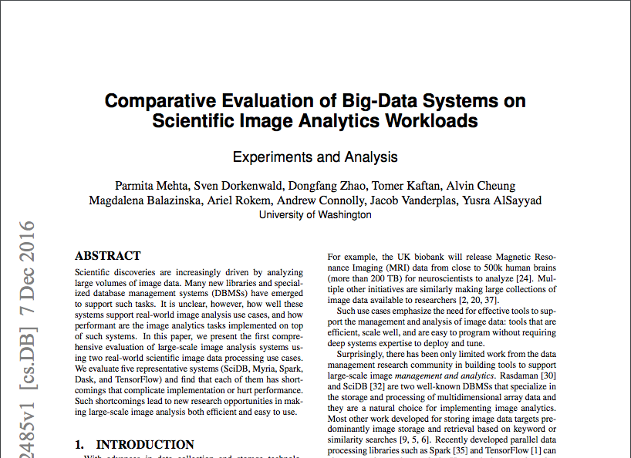
Paper Goal: evaluate existing Big Data systems on real-world scientific image analysis workflows & point the
way forward for database & systems researchers.
Preprint available at https://arxiv.org/abs/1612.02485

